Slide 1

Integrating Globus into Galaxy to Enable FAIRifying Data
Rick Wagner
rick@globus.org

Slide 2
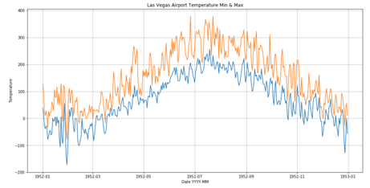


A simplistic data flow…
Data Repository
Request
Analyze
Dataset
Shared endpoint
Dataset
Users should be able to reliably transfer data as part of workflows
Enables simple sharing of workflow results

Slide 3
Plan
Document Globus Auth configuration in Galaxy
Pick a Galaxy workflow to adapt
Install necessary tools
Host input data on remote Globus endpoint
Create a Galaxy tool for Globus Transfers
Install new tool into workspace
Add step in sample workflow to transfer input data
Validate the workflow runs correctly with remote data
Stretch: Tool for sharing results

Slide 4
Help Desired
Galaxy Training:
What’s a good “Hello, World!” workflow for adapting?
Galaxy tool development
Help with tool packaging, good examples
Access user credentials
Example of Calling external APIs

